Slide 1
Gaming for the visually impaired
Three-D Velocity v2.0
Munawar Bijani
Warren Parsons
Lincoln Devine
Gary Young

Slide 2
Biggest complaints – v1.0
“The ‘status’ menu (tab) is pretty pointless”
“The game was disorienting and confusing”
“Too many overlapping sounds”
“Really tough to learn”
“Controls were confusing”
“I don’t know what the sounds mean”
“Cycling through weapons is cumbersome”

Slide 3
Complaints Graph
25 Participants
5 out of the 25 participants complained about the HUD mode.
8 out of the 25 participants complained about the pressing the “S” key to cycle the weapons
9 out of the 25 participants complained about the Lock Menu
All 25 of the participants complained about learning the game sounds in the menu

Slide 4
Goals for version 2.0
Increase effectiveness of controls
Increase efficiency of controls
Make the game easier to learn
Make the controls easier to memorize
These 4 points address the primary complaints seen during usability testing

Slide 5
Changes made in v2.0
Eliminate ‘HUD’ mode
Map plane status buttons to F1-F5
Remove weapon toggle
Now you can directly change to a weapon
Lock-on improvements
Lock-on now gives opponent positions
“Learn Game Sounds” mode
For new players

Slide 6
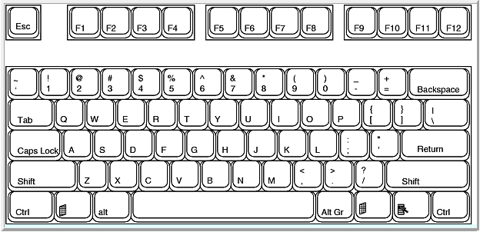
Eliminate ‘HUD’ Mode
HUD mode used to determine various information
Angle of attack
Course
Altitude etc.
Previous method: Tab -> C or N or V…depending
1
2

Slide 7
Eliminate ‘HUD’ Mode
New method
Map the plane status options to F1-F5
F1 – Course
F2 – Angle of attack
F3 – Speed etc…..
1

Slide 8
Eliminate ‘HUD’ Mode
Benefits
Easier to learn and memorize
Thus increasing accessibility + visibility of system status
Makes the plane status a good utility during gameplay
Increases consistency
Tab + random key vs F-keys in a straight line
Ease of use helps prevent errors during gameplay
More efficient
Pressing one button instead of two
Old:
New:

Slide 9
Remove Weapon Toggle
Weapons toggle used to toggle through weapons
Previous method: cycle through weapons with S
1
(May require
Multiple presses)

Slide 10
Remove Weapon Toggle
New Method: Weapons mapped to numbers 1-4
1
Single press

Slide 11
Remove Weapon Toggle
Benefits
Only takes the users reaction time to switch to a weapon
Enhances user control by allowing immediate switching
Increased player recognition of the system as time goes on
Drawbacks
Requires user memorization
Increased hand movement
We believe the benefits outweigh the drawbacks
Old:
New:

Slide 12
Improved Lock-on
Previous functionality
Read out nearby targets and press enter to lock on
Ordered by “player number” (player 1 then player 2 etc.)
New functionality
Read out nearby targets positions
Ordered by distance from player aircraft, closest to farthest
Benefits
Players better able to recognize location of enemy aircraft
Increases visibility of system status
Increased flexibility in means of finding enemy position
Old:
New:

Slide 13
Added “Learn Game Sounds” Mode
Brand new feature
Players scroll through menu
Name of the sound is announced as player scrolls
Player presses ‘enter’ key to hear the sound
Benefits
Help increase player recognition of sounds
Increase available help and documentation
Help prevent user errors during gameplay
Increase overall learnability of the game

